Slide 1
Communications Tools for Section and Branch Leaders
By Tirza Austin
Senior Manager, Online Community
American Society of Civil Engineers

Slide 2

Agenda
Introduction
Institute Communities
Events
Informz
Next Steps

Slide 3

Higher Logic = Vendor
Thrive = Software
ASCE Collaborate = Website
Informz = Email Marketing Module
Notes:
ASCE Collaborate has upgraded to Thrive. This new platform has improved functionality and new features including Informz (an email marketing tool) that will be replacing Constant Contact on August 4^{th.}

Slide 4

Platform Goals
Improve
Improve data security, data governance, and compliance.
Support
Support volunteer leaders by providing a useful, convenient, and affordable platform to support member communications and event registration.
Provide
Provide a more consistent messaging, brand and user experience across the member experience.
Access
Access analytics for local member engagement and contribute to the 360-degree member view.
Ensure
Ensure a sustainable level of support for the platform/system.
Notes:
A core group of ASCE staff started evaluating platforms in the summer of 2022 before deciding to make this switch. The goals of these platform included the following five goals:
Improve data security, data governance, and compliance.
Support volunteer leaders by providing a useful, convenient, and affordable platform to support member communications and event registration.
Provide a more consistent messaging, brand and user experience across the member experience.
Access analytics for local member engagement and contribute to the 360-degree member view.
Ensure a sustainable level of support for the platform/system.
The next five slides are a matrix of functionality considered for each goal. For the sake of time, I will not go through each element on each slide, but I will be sharing my slide deck for you to review at your convenience.

Slide 5
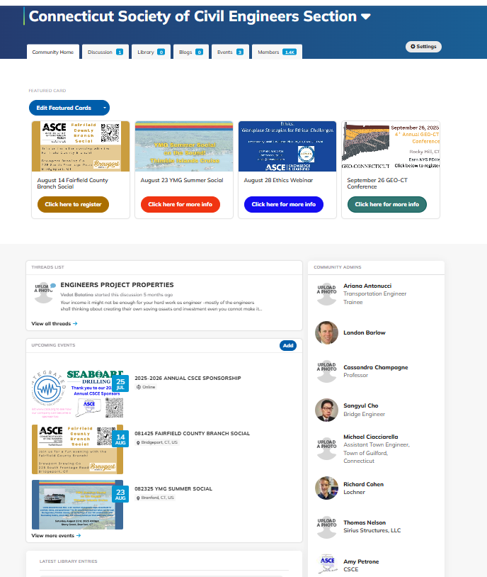
Online Community
Populated by the ASCE member database
Promotional Section
Event section
Members can communicate via discussions and the directory
File storage
Email community feature

Slide 6

Event Manager
Integrated with the ASCE membership database
Member/nonmember/student registration prices based on ASCE record
Streamlined reporting
Automated event emails
No additional charge for the use of the platform
Integrated with Stripe, Checkpoint and PayPal to process payments
Notes:
Thrive offers event registration features. Some Sections and Branches, Institutes, and Society level virtual events have been using this functionality since the start of the pandemic. Some highlighted features include:
Registration system is integrated with the ASCE membership database
Member/nonmember/student registration prices based on ASCE record
Events appear on ASCE consolidated calendar
Streamlined reporting
Automated event emails
No additional charge for the use of the platform
Integrated with Stripe, Checkpoint and PayPal to process payments

Slide 7
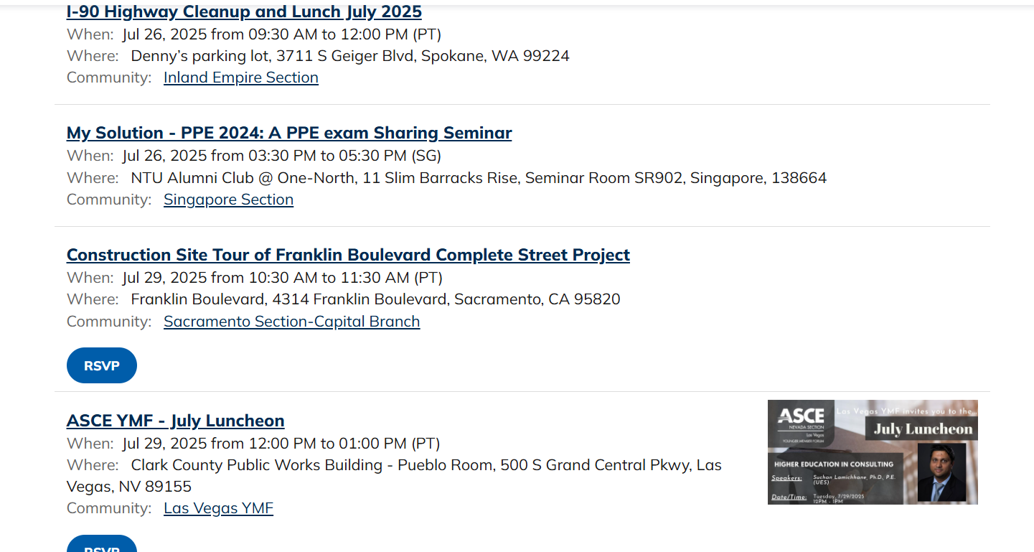
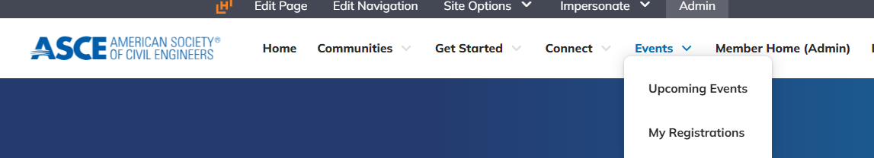
Consolidated ASCE Calendar
Notes:
The upgraded platform offers a consolidated calendar. This calendar includes Society and Institute events stored in our database, continuing education events stored in our database, virtual events, and now Section and Branch events for groups who use the event registration option in ASCE Collaborate. Institutes can use this feature in their respective communities and their events will appear on the ASCE Calendar as well.

Slide 8


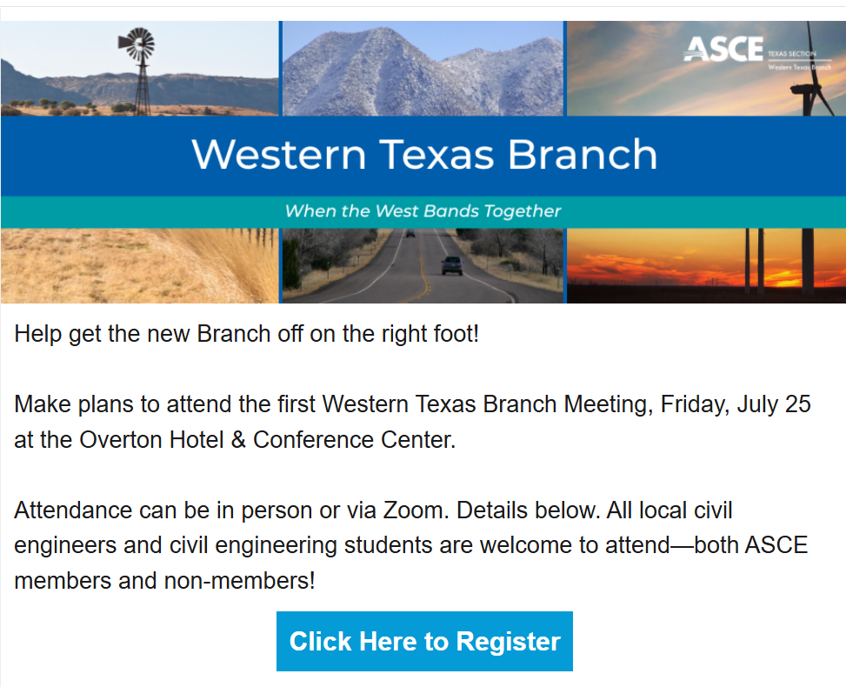
Informz
Notes:
Informz is an email marketing tool that is a new feature in Thrive. The system helps you tailor every email or automated campaign with dynamic content, segmentation, and personalization. The system is integrated with the ASCE membership database so there is no need for you to pull or manage separate lists outside of the system. However, you can upload prospect lists if you would like. This is an example email template that the Midlands Branch has built in the new system.

Slide 9

Additional Features
Unlimited administrator accounts
ASCE branded templates
ASCE Asset Library in the system
ASCE content layouts
Improved reporting that will contribute to a 360-membership view
A/B Testing
Targeted segment groups for emails and email content
Event Campaigns
Improved data security, deliverability, and compliance
Notes:
In addition to being integrated with the ASCE database, Informz provides additional features including:
Unlimited administrator accounts
ASCE branded templates
ASCE Asset Library in the system
ASCE content layouts
Improved reporting that will contribute to a 360-membership view
A/B Testing
Targeted segment groups for emails and email content
Event Campaigns
Improved data security, deliverability, and compliance

Slide 10
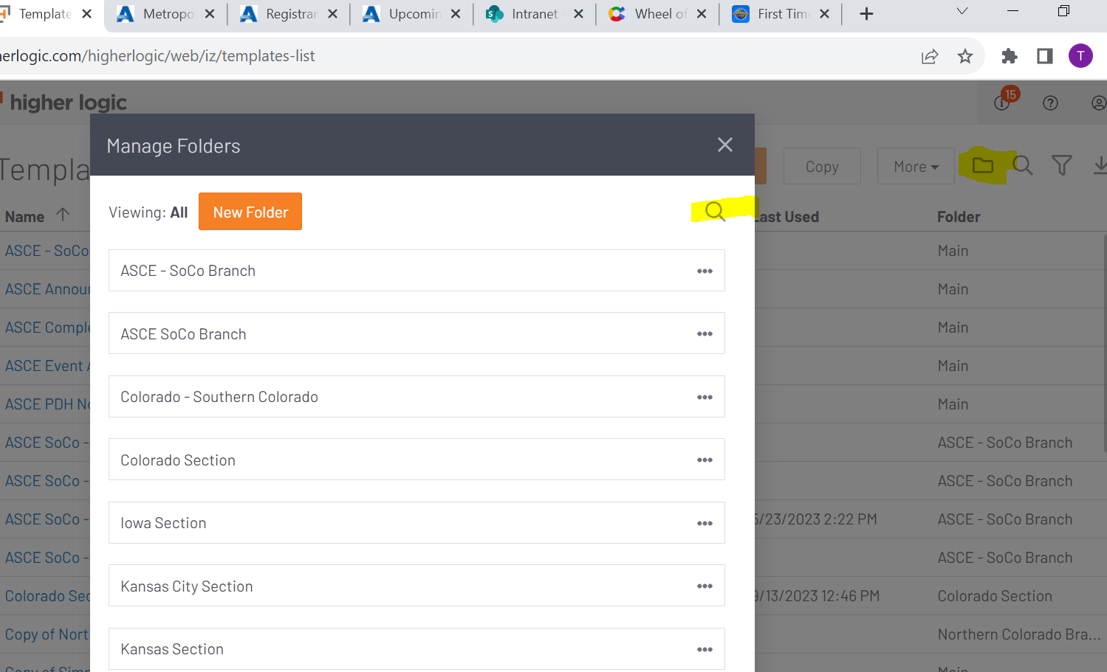
Informz Best Practices – Folders
Templates
Messages
Message Categories
Target Groups
Campaigns
Scheduling calendar
Message Categories
Notes:
Folders help keep your local groups organized. You can add folders in all aspects of the platform. You will see some are already in place for local groups but we recommend you create separate ones for your specific institute chapters.

Slide 11
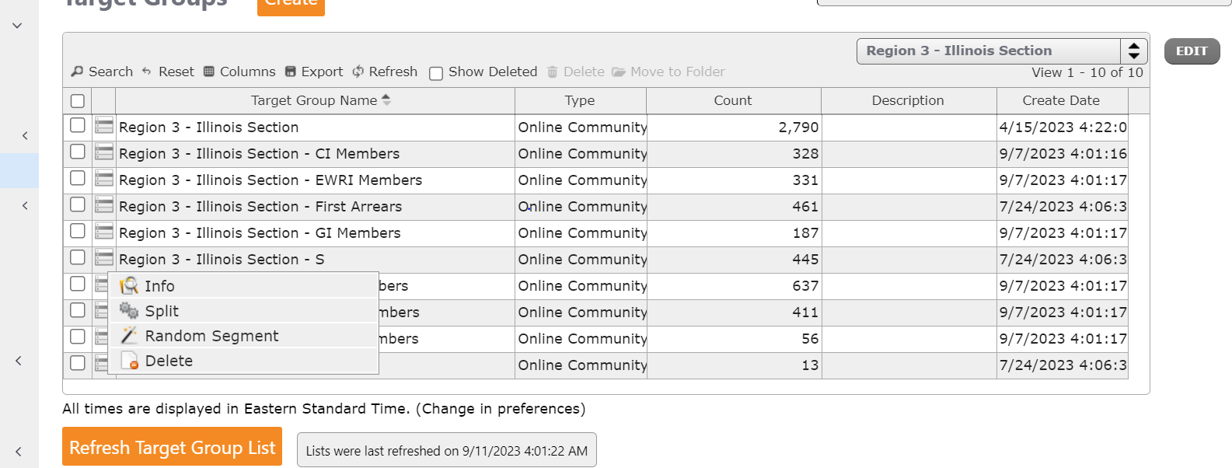
Informz Best Practices - Lists
Contact Tirza Austin at taustin@asce.org to request lists for your institute chapter.
Notes:
Currently you will see five lists for Sections and Branches in their appropriate folders. You can request lists that are institute specific. The list include all members of the institute in a Section/Branch. It does take a few days for these lists to start populating into the system so please allow some time to get these setup.

Slide 12

Informz Best Practices – Communication
Work with local officers to coordinate your plan for communicating with members. When possible, try to collaborate on events and communications.
Notes:
Before requesting credentials, we request you communicate your interest with your Section and Branch officers so you can coordinate communication and event scheduling if you are not already. We have two specific ways for officers to work together.

Slide 13
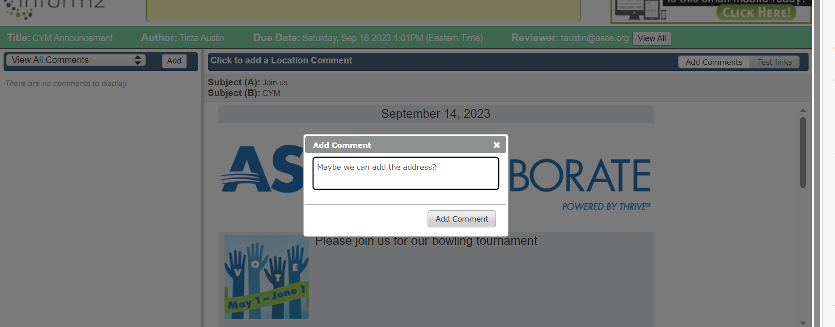
Informz Best Practices – Send for Review
You can send a test email for your officers to review and comment on before you send the email.
Notes:
There is a commenting feature that allows you to send a test for officers in both your institute chapter and section and branch leaders to leave comments in the platform to keep you organized.

Slide 14
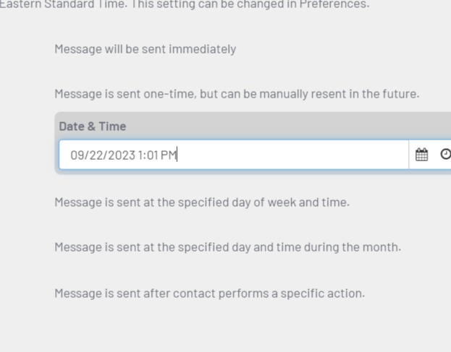
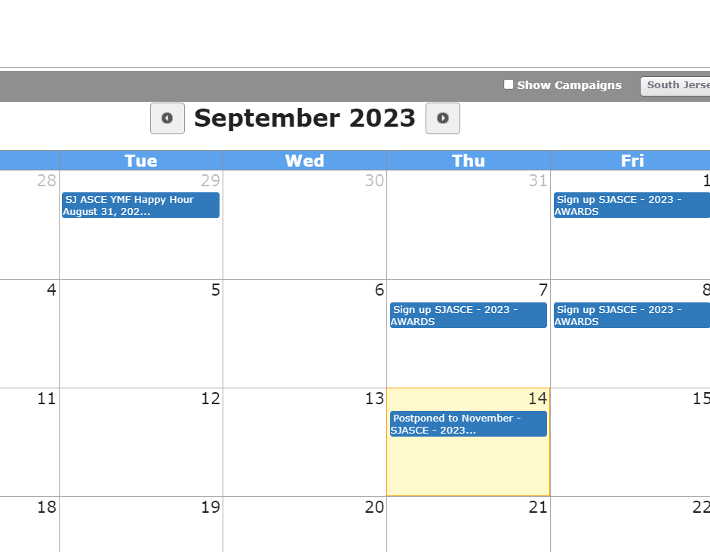
Informz Best Practices – Schedule and Check Mailings
Notes:
You can schedule mailings that will appear in a calendar so you can coordinate when messages are sent so you do not overwhelm your subscribers. You can filter messages based on folder. You can also put a hold without creating the message if you want to block off time for a big event/mailing.

Slide 15
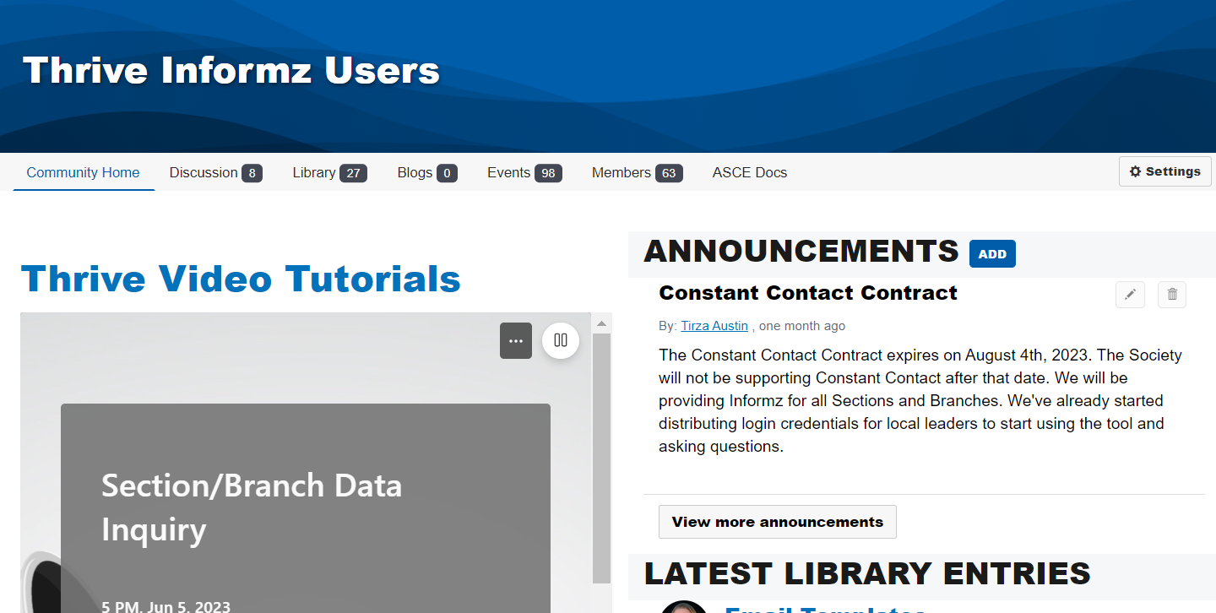
User Group
The user group meets every Tuesday at 2pm ET
We have a community with resources, recordings and training videos
This community has a link to request credentials
Users can also use this space to communicate with each other
Notes:
I encourage you to join the ASCE user group. The group meets every Tuesday at 2pm ET. Please contact Tirza Austin at taustin@asce.org and you will be forwarded the meeting invite.
We also have a community with resources, recordings and training videos. You can request to join this community or Tirza Austin can add you. The link is: https://collaborate.asce.org/communities/community-home?CommunityKey=6eb5ef45-0549-4878-9887-0185f5b147bd
We are also encouraging users to use this space to communicate with each other. We hope you find it helpful.

Slide 16
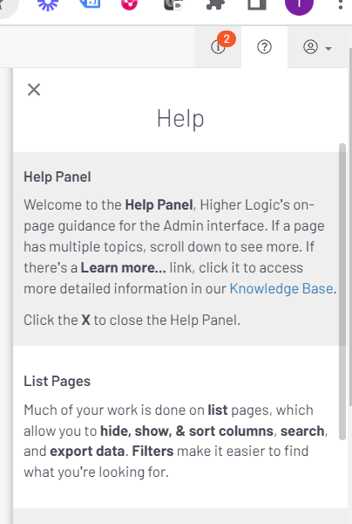
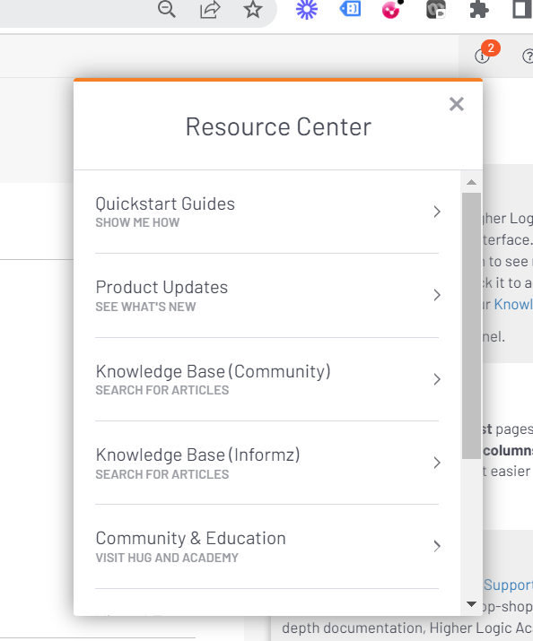
Training Resources
Notes:
In the Informz platform you will see a help section if you click on the question mark in the upper-right-hand part of the screen. You will also see an information section if you click on the “I” in the upper-right-hand side of the screen. These are great resources from the vendor for you to leverage. ASCE is also creating video tutorials for you to access at https://collaborate.asce.org/welcome-thrive. I hope you take advantage of these resources. If you notice topics that you would find helpful or gaps in training, please contact taustin@asce.org

Slide 17
Next Steps
Talk with your Section and Branch Officers about using their communication strategy and you using the platform.
Request access to credentials(contact taustin@asce.org)
Sign the ASCE user agreement to request credentials (available in the User Group Community).
Watch training videos
Attend user group meetings

Slide 18
Questions?
Contact: Tirza Austin
taustin@asce.org
Notes:
Thank you for joining us today. Do you have any questions?
Please contact Tirza Austin at taustin@asce.org if you have any questions. Thank you for your participation in this project.

